Slide 1
Sreenivas Kasulanati
Supraja Kodiganti

Slide 2
Generating Mood-Specific Song Lyrics Using NLP, LSTM and RNN

Slide 3
Project Objectives
Develop an NLP model using LSTM and RNN to generate song lyrics based on different moods, such as positive and negative.
Employ sentiment analysis with OpenAI API to classify lyrics into positive or negative categories more effectively.
Evaluate the LSTM and RNN models' ability to generate mood-specific lyrics and compare their performance with existing approaches.

Slide 4
Statement of Value
This project innovatively combines NLP techniques, including LSTM and RNN, with music lyric generation to automate the creation of emotionally resonant content.
By integrating OpenAI API, the project aims to enhance sentiment analysis accuracy and lyric coherence, benefiting songwriters, artists, and music producers.
It advances NLP research by exploring the application of advanced models in generating creative and contextually relevant text in the music domain.

Slide 5
Review of the State of the Art and Relevant Works
Pyrovolakis et al. demonstrated mood detection in songs using separate analysis of audio signals and lyrics[3].
Mahey discussed sentiment and emotion analysis in lyrics using NLP, citing a case study on Biggie Smalls' "Suicidal Thoughts"[6].

Slide 6
Methodology
Algorithms:
Datasets:
LSTM and RNN for lyric generation, sentiment analysis
https://www.kaggle.com/datasets/terminate9298/songs-lyrics?select=lyrics.csv
Models:
Tools and Techniques:
Sentiment analysis, RNN, LSTM
NLTK, Scikit-learn, OpenAI API, TensorFlow, Matplotlib, Seaborn, Spacy

Slide 7
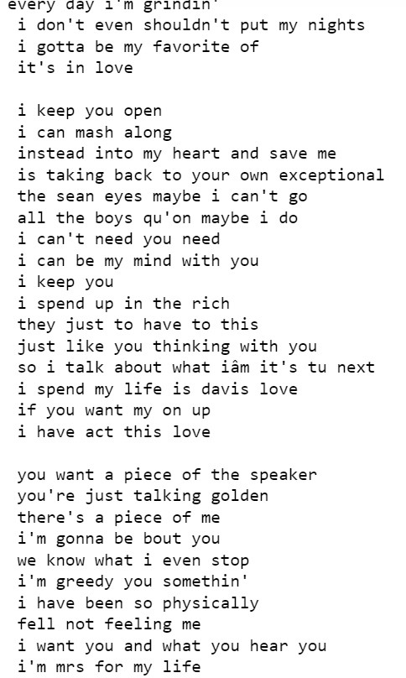
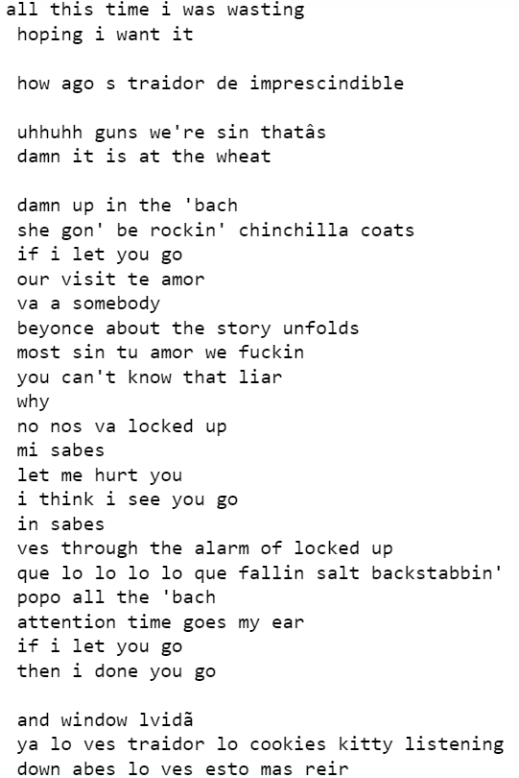
Results from RNN model:
Positive Song Lyric Generation Negative Song Lyric Generation

Slide 8
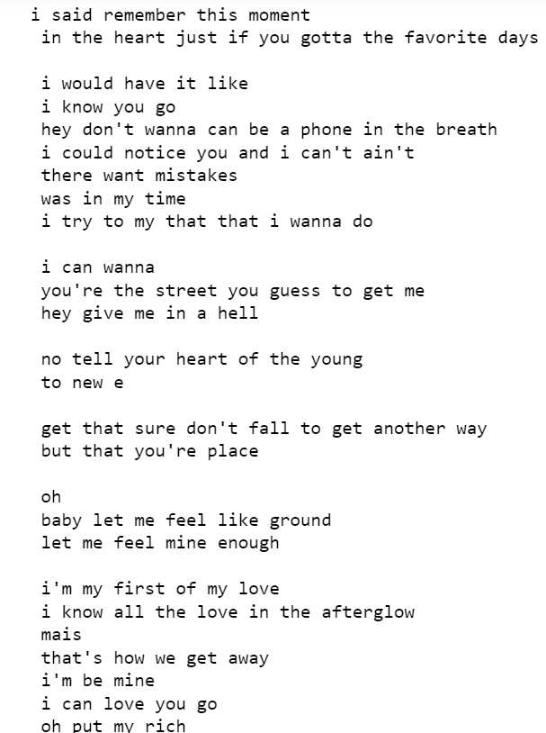
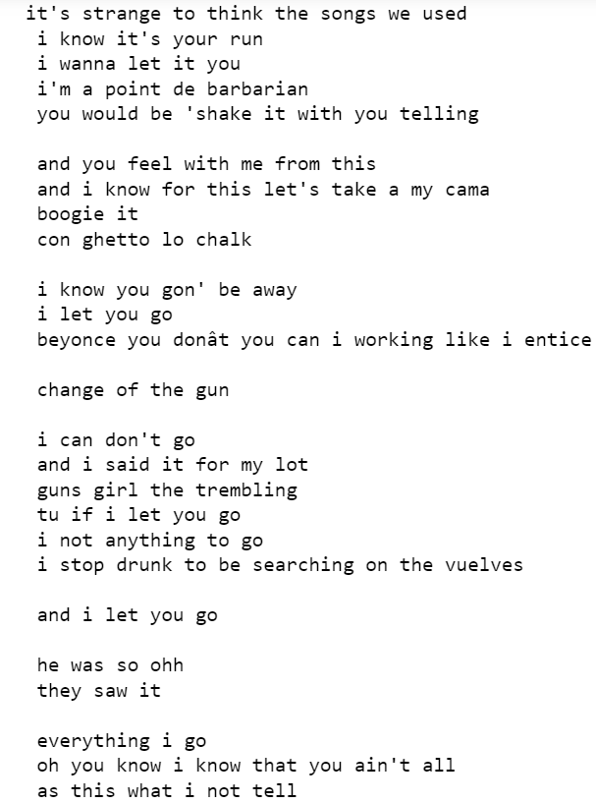
Results from LSTM model:
Positive Song Lyric Generation Negative Song Lyric Generation

Slide 9
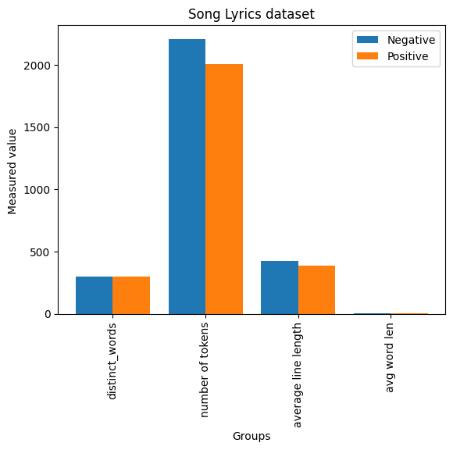
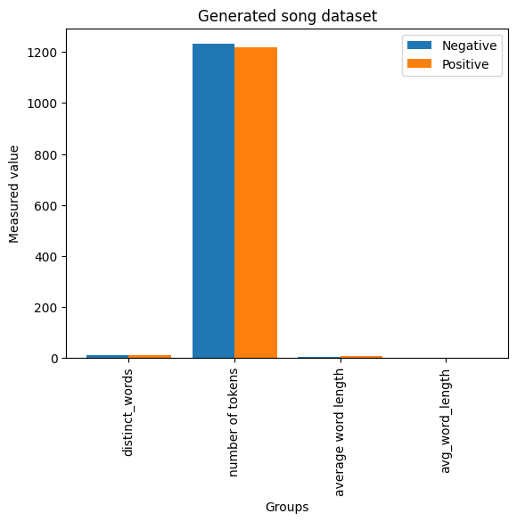
Result's Analysis:

Slide 10
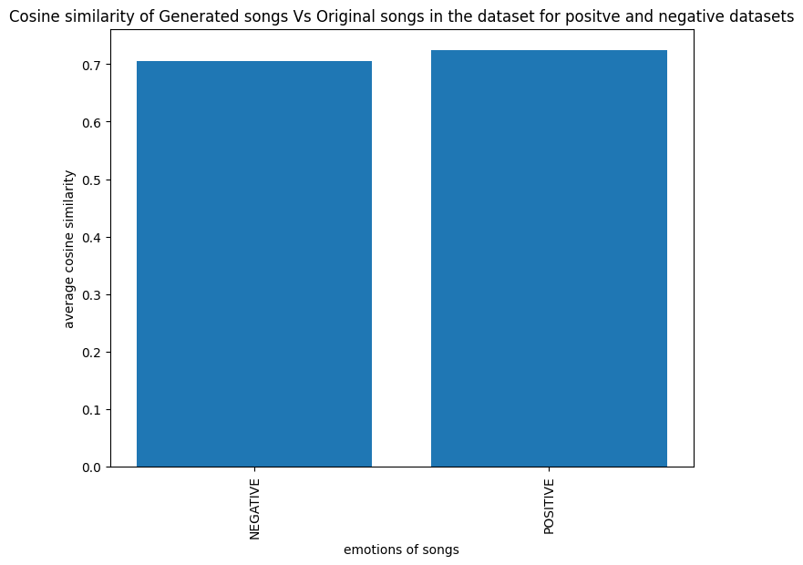
Model Evaluation
Metrics:
Accuracy of sentiment classification, cosine similarity between generated and existing lyrics, average length of generated lyrics.
COSINE SIMILARITY(POSITIVE):0.7251916284454906
COSINE SIMILARITY(NEGATIVE):0.7057735946610217

Slide 11

THANK YOU

